Slide 1
Screening for Order Parameter Redundancy
Pavan Ravindra

Slide 2
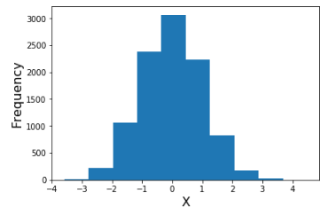
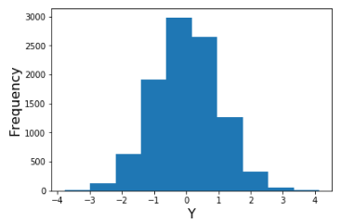
Order Parameter Selection
Biophysical knowledge or intuition
Redundancy not always obvious

Slide 3
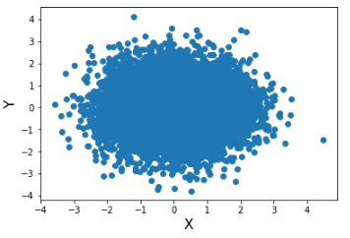
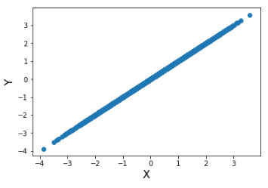
Answer?
Vs.
You would need to look at joint distribution for every pair of OP’s!
Always inconvenient, sometimes impossible

Slide 4
Description of Problem
Input:
Short unbiased trajectory
Output
Smaller set of order parameters
Large order parameter dictionary

Slide 5
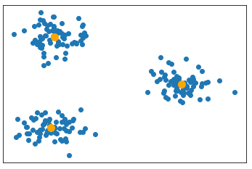
Overview of Approach
Cluster OP’s in some meaningful space
Select a single OP from each cluster
Return best set of OP’s
Problems:
No identifiable low-dimensional OP space
Number of clusters
OP 2
OP 1
Notes:
K means algorithm

Slide 6
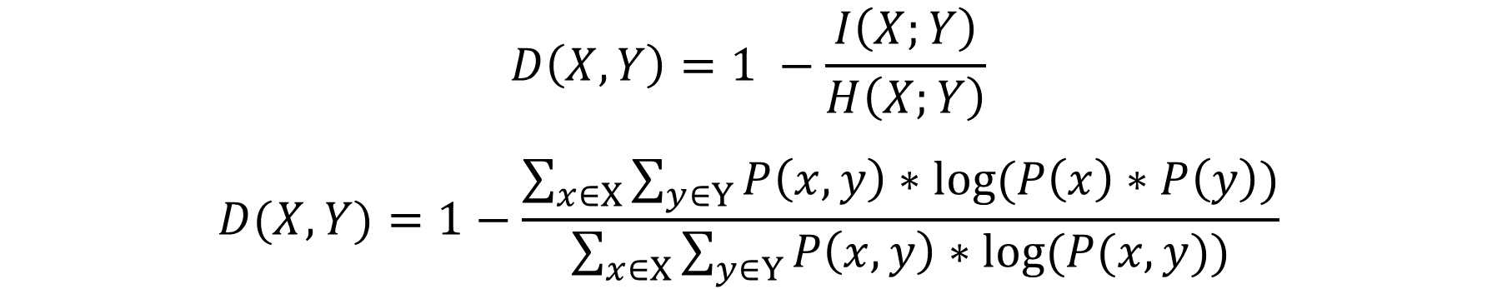
Mutual Information Based Distance Function
$$D\left(X,Y\right)=1 −\frac{I\left(X;Y\right)}{H\left(X;Y\right)}$$
$$D(X,Y)=1−\frac{\sum_{x∈X}{\sum_{y∈Y}{P\left(x, y\right)∗log⁡(P\left(x\right)∗P\left(y\right))}}}{\sum_{x∈X}{\sum_{y∈Y}{P\left(x, y\right)∗log⁡(P(x,y))}}}$$
M.Aghagolzadeh,H.Soltanian-Zadeh,B.Araabi,andA.Aghagolzadeh,in2007 IEEE International Conference on Image Processing,Vol. 1 (IEEE, 2007) pp. I–277
Symmetric: D(X,Y) = D(Y,X)
Normalized in range [0, 1]
Distance of 0 corresponds to perfect correlation

Slide 7
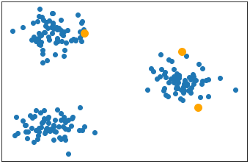
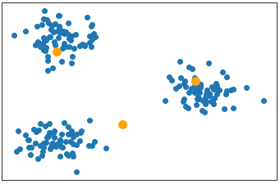
K-Means Clustering
OP 2
OP 2
OP 1
OP 1
Initial centroids in same space as S
Centroids are flexible (not in S)
Move from one cluster to another
J. MacQueen, inProceedings of the fifth Berkeley symposium on mathematical statistics and probability,Vol. 1 (Oakland, CA, USA, 1967) pp. 281–297

Slide 8
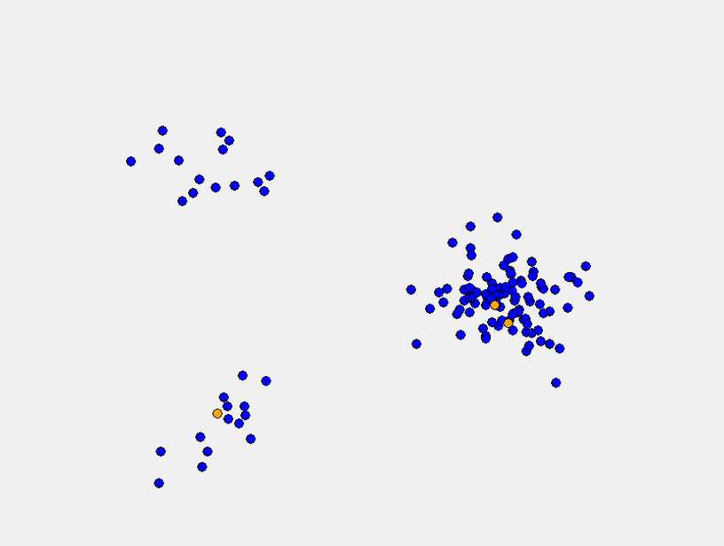
Requirements of Clustering in this System
Centroids must be in the original data set
Non-element centroids are physically meaningless
Initial randomized centroids can get stuck in the same cluster

Slide 9
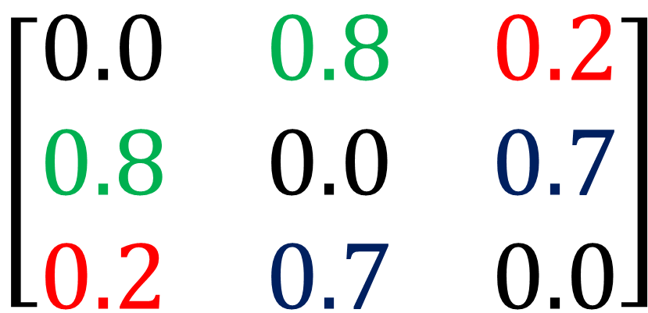
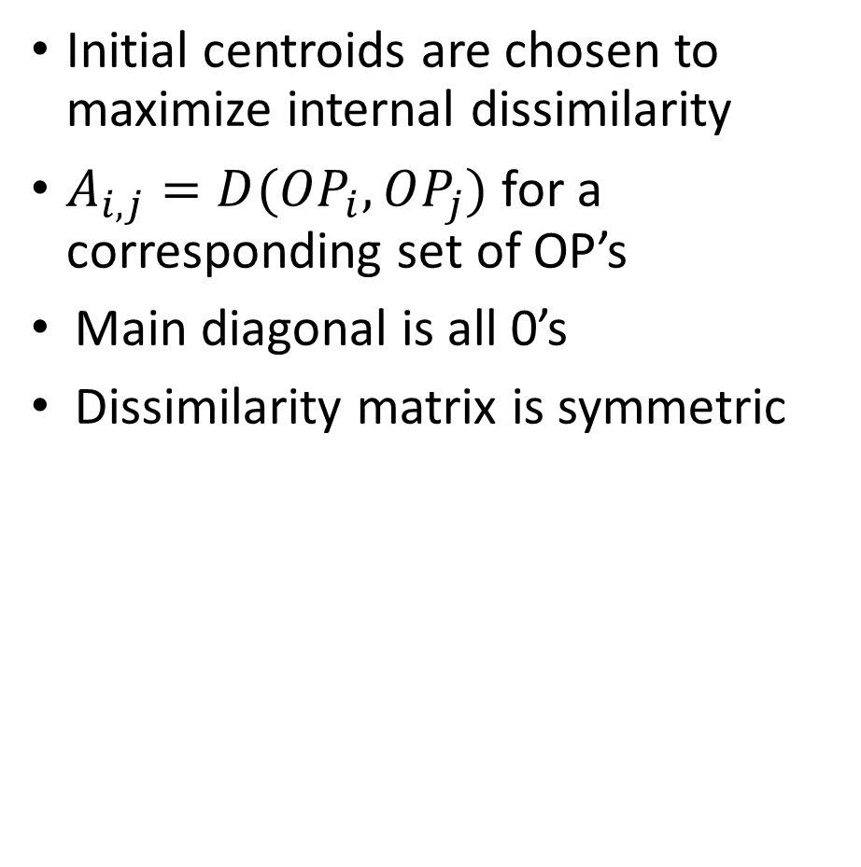
Dissimilarity Matrix
Initial centroids are chosen to maximize internal dissimilarity
$A_{i,j}=D(OP_{i},OP_{j})$ for a corresponding set of OP’s
Main diagonal is all 0’s
Dissimilarity matrix is symmetric
$$\left[\begin{matrix}0.0 & 0.8 & 0.2 \\ 0.8 & 0.0 & 0.7 \\ 0.2 & 0.7 & 0.0\end{matrix}\right]$$

Slide 10
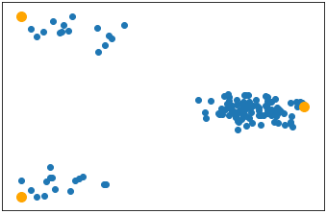
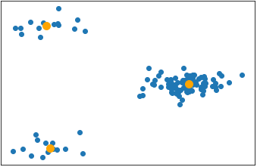
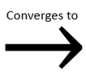
New Starting Point for Clustering
Initial centroids are selected to be in different clusters
Starting centroids ARE NOT good at describing entire system
For proper k, centroids do not need to cross gaps

Slide 11
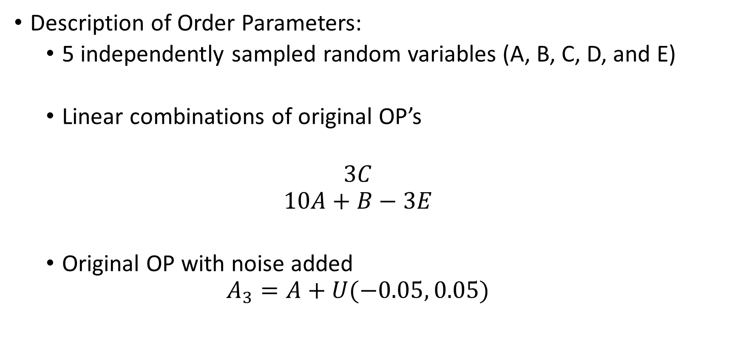
Model System
Description of Order Parameters:
5 independently sampled random variables (A, B, C, D, and E)
Linear combinations of original OP’s
$$3C$$
$$10A+B−3E$$
Original OP with noise added
$$A_{3}=A+U(−0.05, 0.05)$$

Slide 12
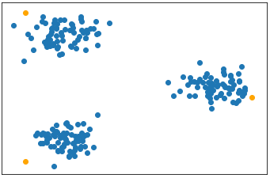
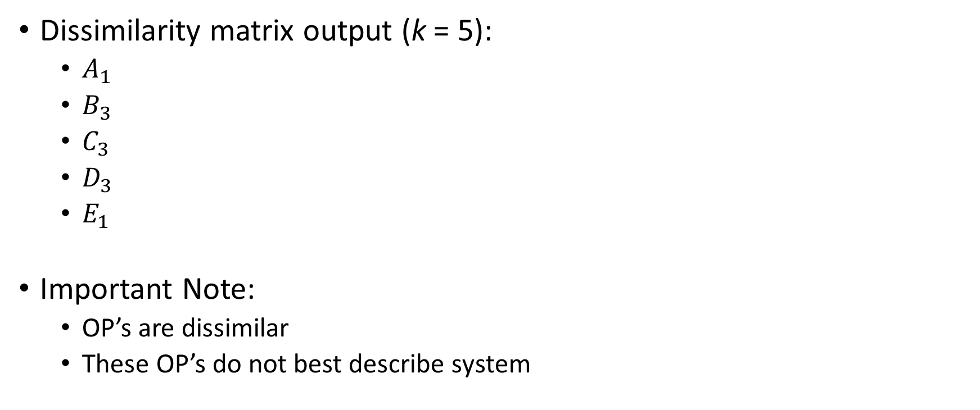
Model System (Results)
Dissimilarity matrix output (k = 5):
$A_{1}$
$B_{3}$
$C_{3}$
$D_{3}$
$E_{1}$
Important Note:
OP’s are dissimilar
These OP’s do not best describe system
OP 2
OP 1

Slide 13
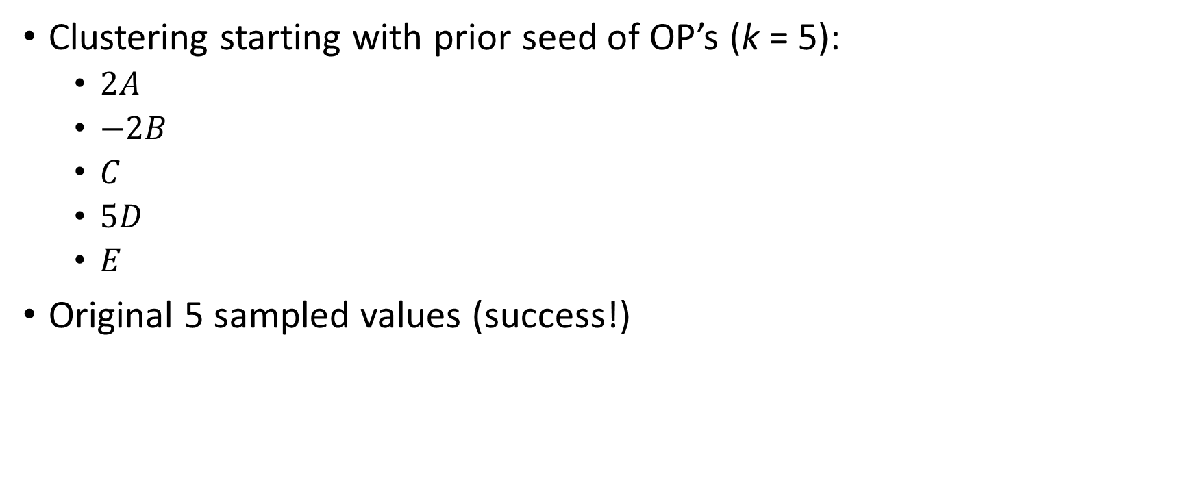
Model System (Results)
Clustering starting with prior seed of OP’s (k = 5):
$2A$
$−2B$
$C$
$5D$
$E$
Original 5 sampled values (success!)
OP 2
OP 1

Slide 14
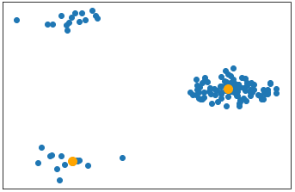
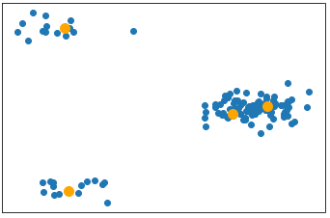
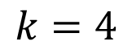
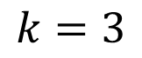
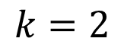
Determining number of clusters
What we have:
For a given number k, we can find the k best OP’s to describe entire set of OP’s
What we don’t have:
A robust method of determining the best k for a set of OP’s
$$k=2$$
$$k=3$$
$$k=4$$

Slide 15
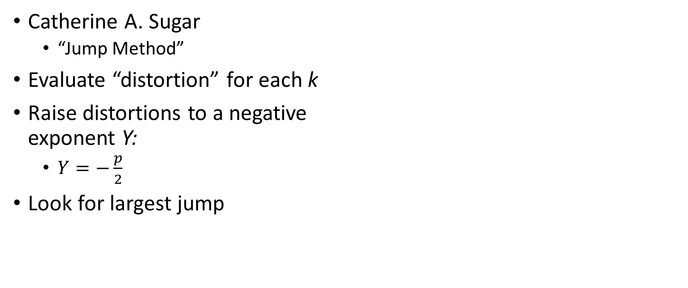
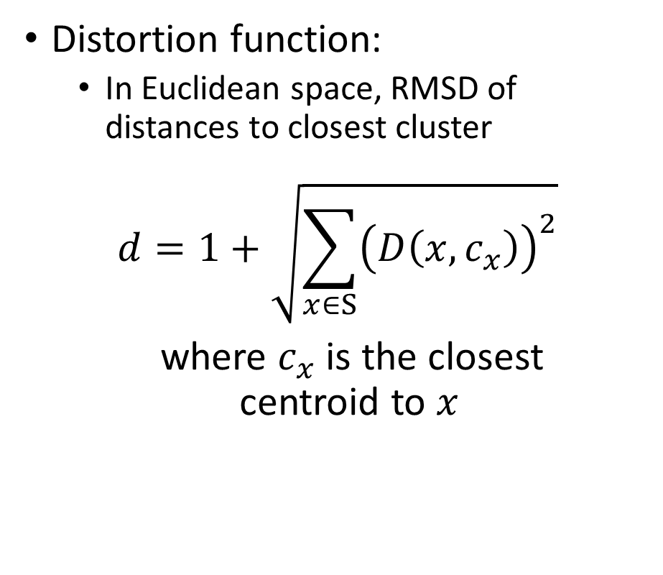
Rate Distortion Theory
Catherine A. Sugar
“Jump Method”
Evaluate “distortion” for each k
Raise distortions to a negative exponent Y:
$Y=−\frac{p}{2}$
Look for largest jump
Distortion function:
In Euclidean space, RMSD of distances to closest cluster
$$d=1+\sqrt{\sum_{x∈S}{{\left(D\left(x,c_{x}\right)\right)}^{2}}}$$
where $c_{x}$ is the closest centroid to $x$
Notes:
citations

Slide 16
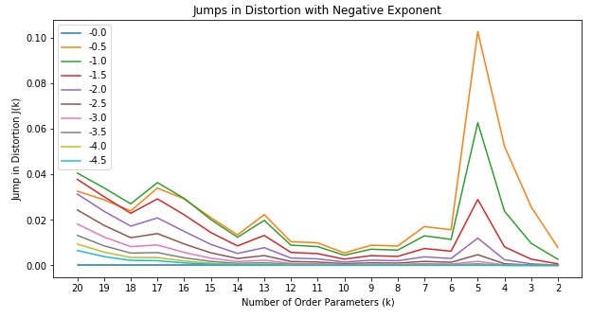
Back to Model System
Clear jump at k = 5 consistent for all choices of Y

Slide 17
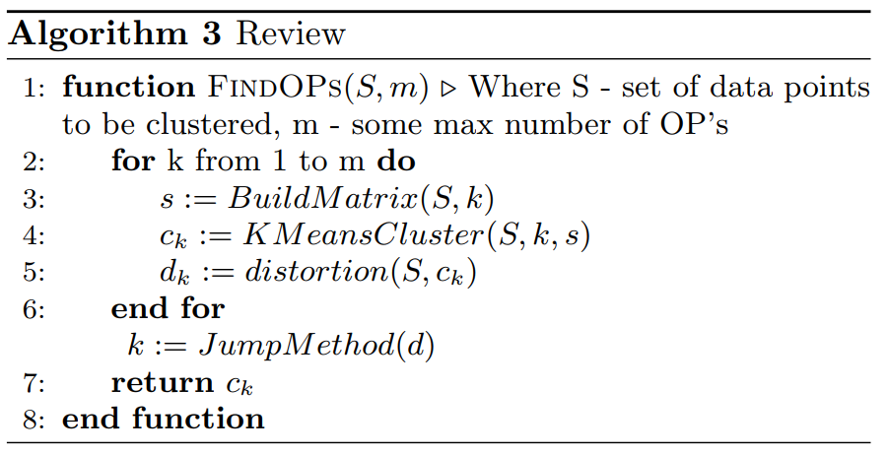
Review of Entire Algorithm

Slide 18
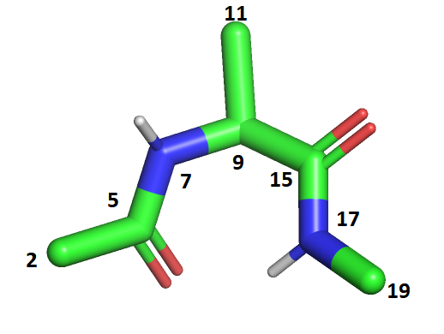
Alanine Dipeptide
Input Dihedrals
5,7 – 9,15
5,7 – 9,11
Input Distances:
2 -> 17
2 -> 19
Output Dihedrals
5,7 – 9,15
7,9 – 15,17
Output Distances:
2 -> 17
2 -> 19
7,9 – 15,17
11,9 – 15,17

Slide 19
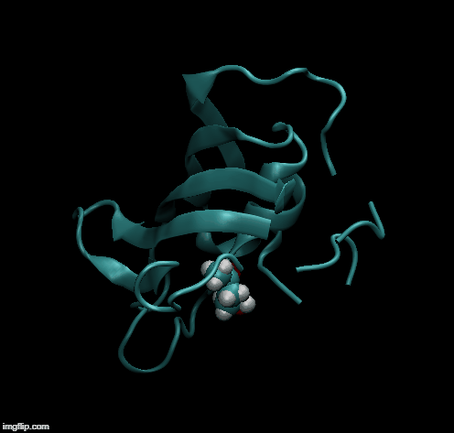
FKBP/BUT Protein-Ligand System
107 amino acids (alpha carbons) in protein
4 carbons in ligand
4 * 107 = 428 initial order parameters
Use these 428 OP’s in bound trajectory as input to algorithm:
8 output order parameters
Notes:
Add image (cartoon)

Slide 20
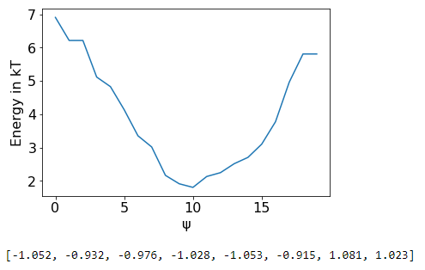
Results of SGOOP (Bound Phase)

